Slide 1

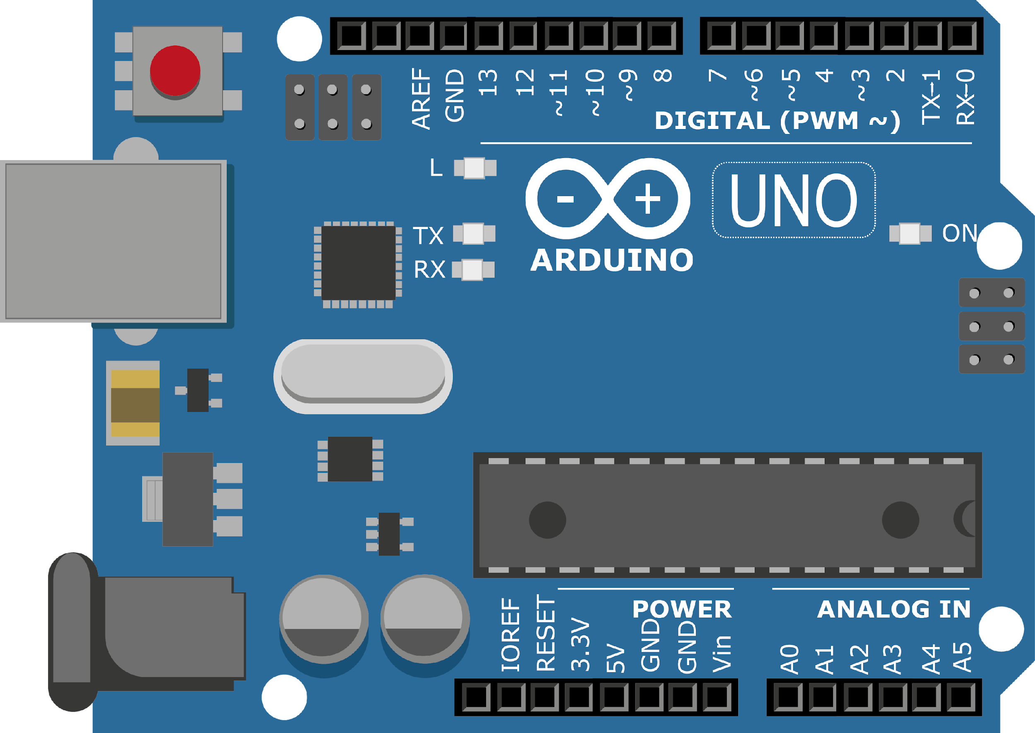
ARDUINO MASTER CLASS
15
Brain Controlled Robot

Slide 2
15 AGENDA
02
03
01
Brain Controlled Robot
BCI
Q & A

Slide 3
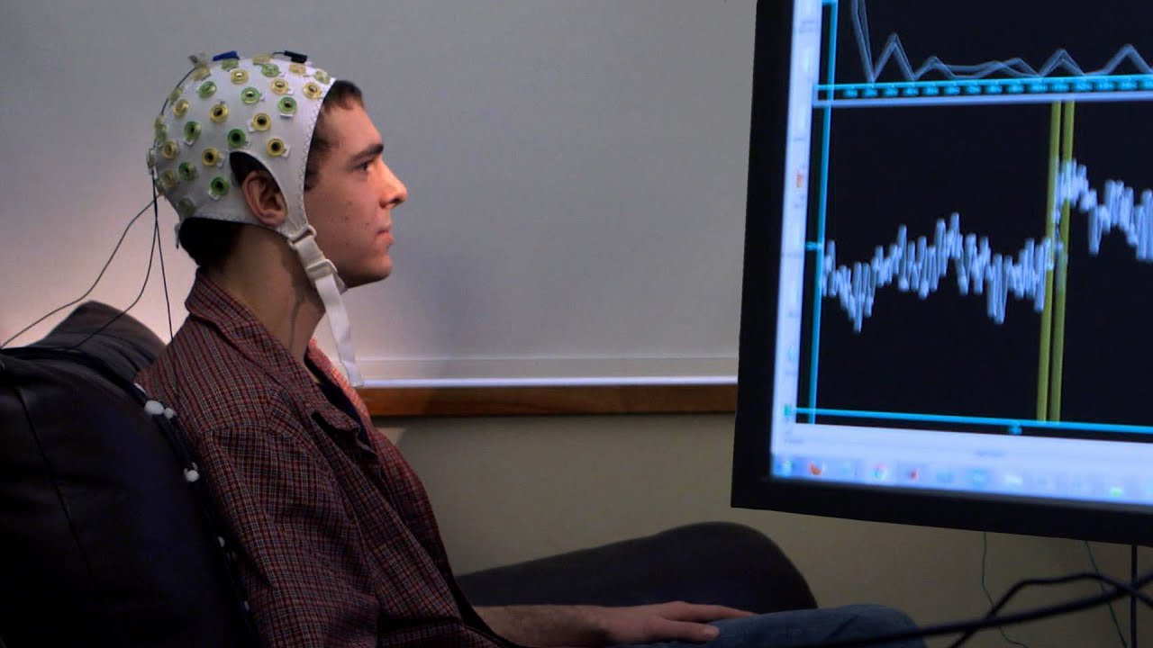
Brain Computer Interface
A brain-computer interface (BCI) is a computer-based system that acquires brain signals, analyzes them, and translates them into commands that are relayed to an output device to carry out a desired action. In principle, any type of brain signal could be used to control a BCI system.

Slide 4
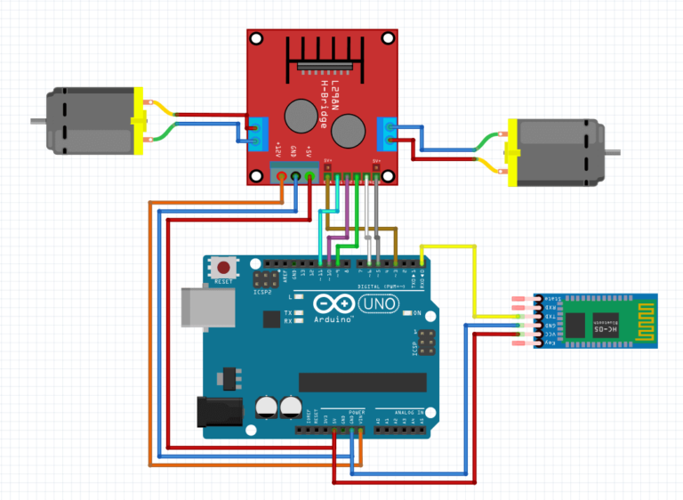
Brain Controlled Robot

Slide 5

INTERVIEW QUESTIONS
EEG Bands
Invasive vs Non Invasive electrode
Bio Signal

Slide 6
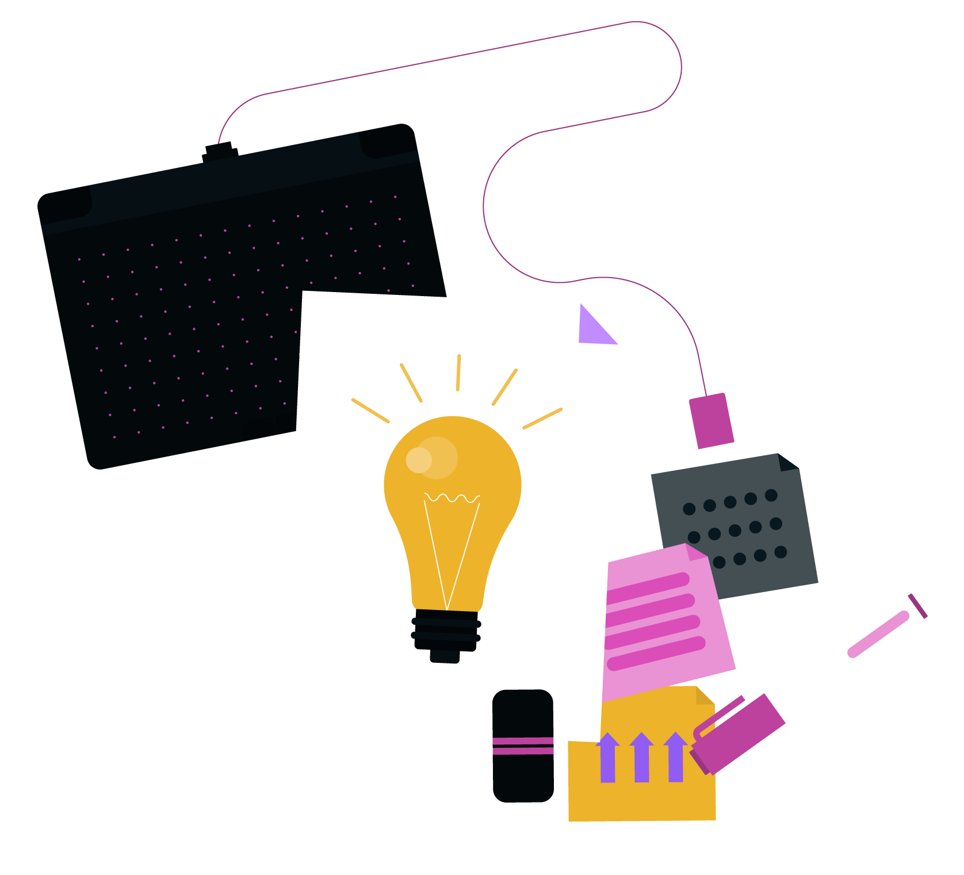
THANKS!

